Slide 1
LOCUS: User-Perceived Delay-Aware Service Placement and User Allocation in MEC Environment
1st Yu Chen
2nd Sheng Zhang
3rd Yibo Jin
4th Zhuzhong Qian

Slide 2
CONTENT
NO.1
Background Knowledge
NO.2
Problem and System Model
NO.3
Solution
NO.4
My Work

Slide 3
1

Slide 4
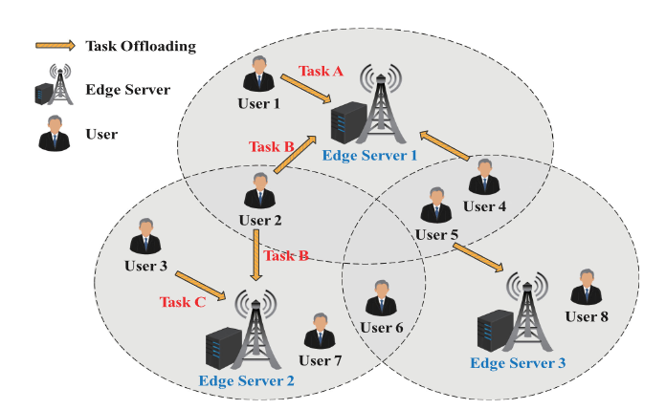
Background Knowledge
The new generation of applications produces a huge amount of data and requires a variety of services, which need ultra-low latency, high bandwidth and resource consumption.
This enable Multi-access Edge Computing (MEC) to improve the provided services.

Slide 5
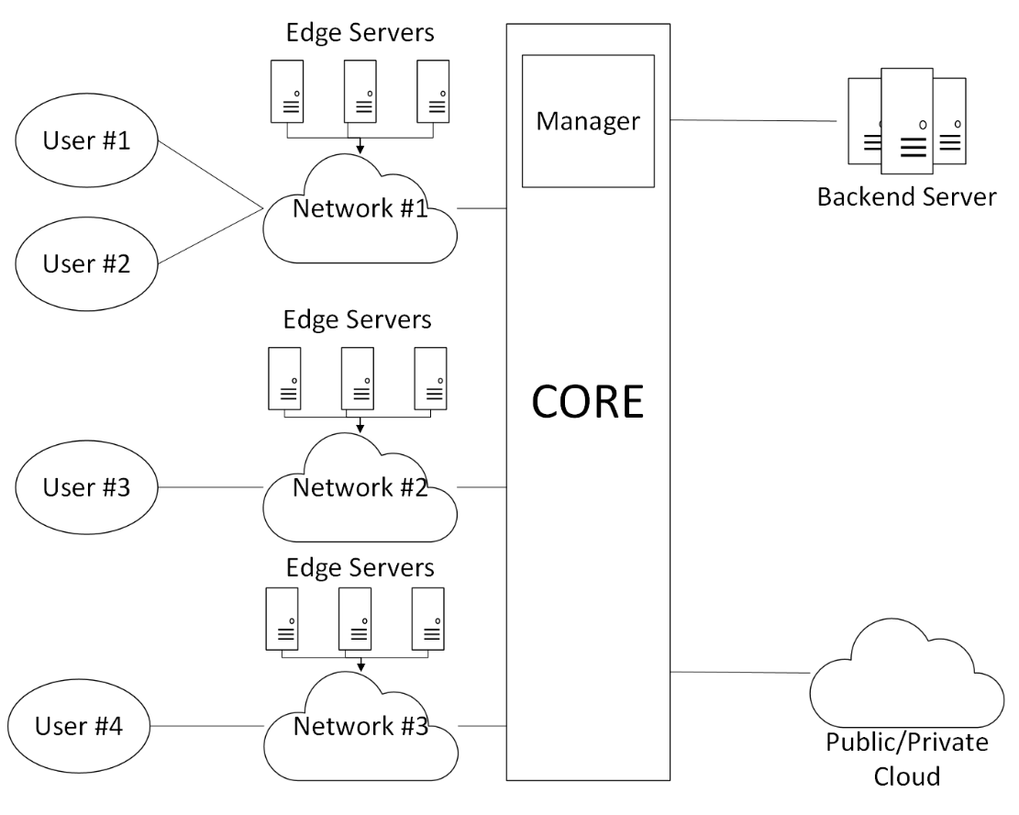
Background Knowledge
Edge computing is a distributed computing framework that processes data closer to the source, rather than sending it to a central data center.
This can reduce the latency of the application and reduce the data volume among the network.

Slide 6
Background Knowledge
Edge computing is a distributed computing framework that processes data closer to the source, rather than sending it to a central data center.
Image Analyze
Image Analyze
Service
This can reduce the latency of the application and reduce the data volume among the network.
Video Analyze Service
Video Analyze

Slide 7
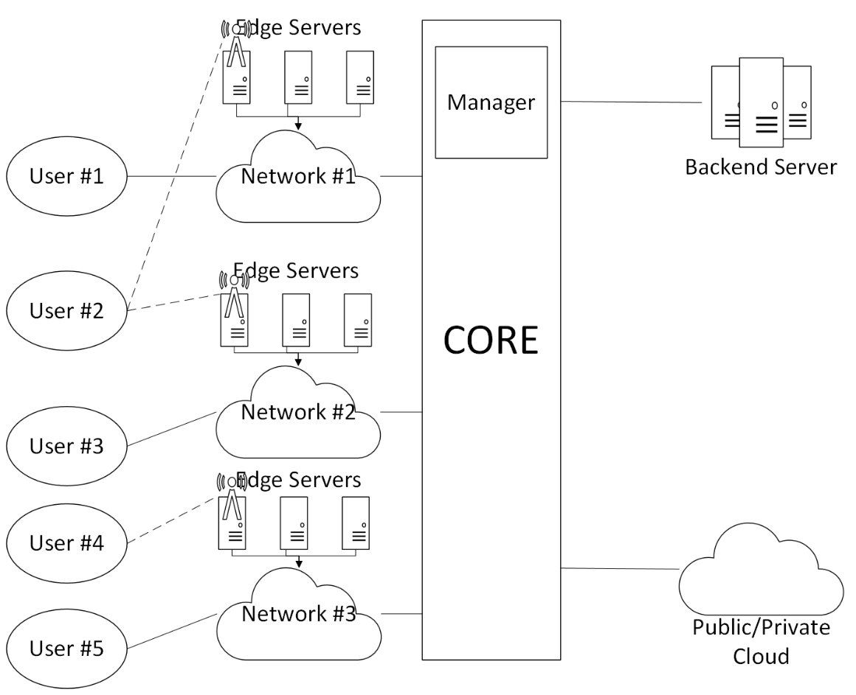
Background Knowledge
For Multi-access Edge Computing, the users could be anywhere. They can connect to the network through the base station or the cable.
This drive the latency to minimum and even enable the ability for optimal the model for the better quality of analyze result.

Slide 8
Background Knowledge
For Multi-access Edge Computing, the users could be anywhere. They can connect to the network through the base station or the cable.
Video Analyze Svc. Part 1
Image Analyze
Image Analyze
Service
This drive the latency to minimum and even enable the ability for optimal the model for the better quality of analyze result.
Video Analyze
Video Analyze Svc. Part 2
Machine Learning

Slide 9
Background Knowledge
Scheduling in multi-access edge computing involves assigning computation tasks to edge servers, installing service to edge servers, managing dataflow, allocating user to edge servers and so on.
Considering energy efficiency, latency, QoE, utility and more.
Manager have different methods to offload the task, including convex optimization, heuristic algorithm, machine learning, game theory, federated learning and other methods.

Slide 10

Background Knowledge
Scheduling in multi-access edge computing involves assigning computation tasks to edge servers, installing service to edge servers, managing dataflow, allocating user to edge servers and so on.
Considering energy efficiency, latency, QoE, utility and more.
Manager have different methods to offload the task, including convex optimization, heuristic algorithm, machine learning, game theory, federated learning and other methods.

Slide 11
2

Slide 12
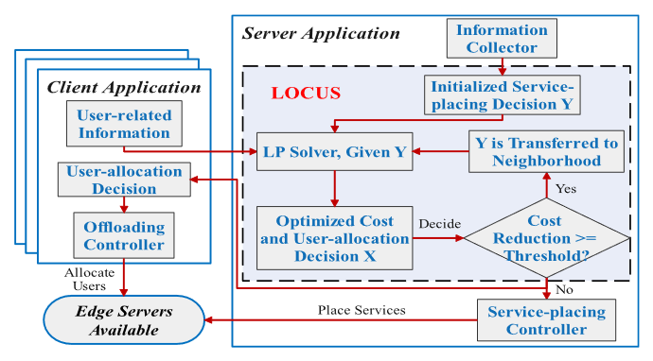
Problem
The paper’s primary issue is minimizing total offloading costs, which include placement, usage, and energy costs under the constrain of user-perceived delay.
Current solutions often fail to jointly address service placement and user allocation with strict delay constraints​.

Slide 13
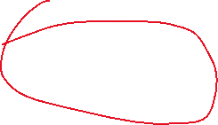

Problem
The paper’s primary issue is minimizing total offloading costs, which include placement, usage, and energy costs under the constrain of user-perceived delay.
Current solutions often fail to jointly address service placement and user allocation with strict delay constraints​.

Slide 14
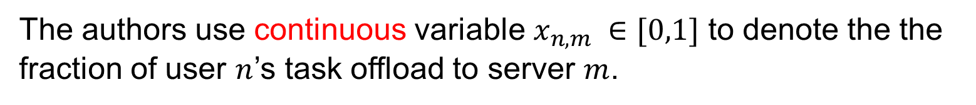
System Model
The authors use continuous variable $x_{n,m} ∈[0,1]$ to denote the the fraction of user $n$’s task offload to server $m$.

Slide 15

System Model
Crowd Feature
Classfier
Bike Feature
Classfier
Objett
Detaction
The authors use binary variable $y_{m,s} ∈\{0,1$} to denote whether service $s$ is placed at edge server $m$.

Slide 16
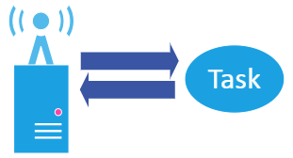
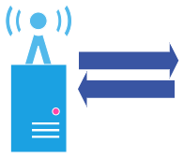

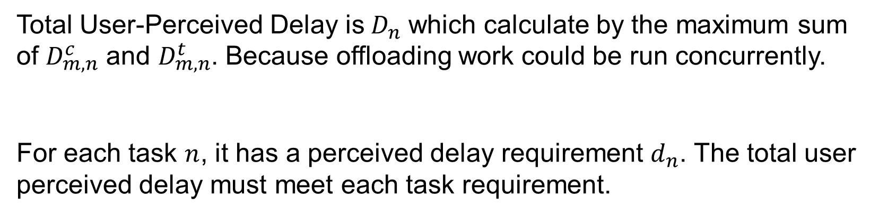



System Model
$$D_{m,n}^{c}$$
$$D_{m,n}^{c}$$
$$D_{m,n}^{t}$$
$$D_{m,n}^{t}$$
Total User-Perceived Delay is$D_{n}^{ }$ which calculate by the maximum sum of $D_{m,n}^{c}$ and $D_{m,n}^{t}$. Because offloading work could be run concurrently.
For each task $n$, it has a perceived delay requirement $d_{n}$. The total user perceived delay must meet each task requirement.

Slide 17



System Model
Crowd Feature
Classfier
$C^{p}$
Bike Feature
Classfier
$C^{p}$
Objett
Detaction
$C^{p}$
$C^{p}$ is the service placement cost. Each service placement has a cost.

Slide 18

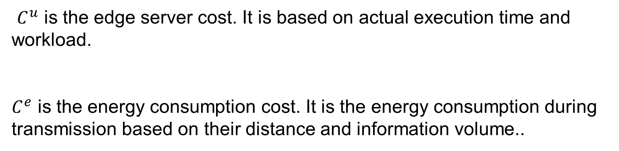



System Model
$$C^{u}$$
$$C^{u}$$
$$C^{e}$$
$$C^{e}$$
$C^{u}$ is the edge server cost. It is based on actual execution time and workload.
$C^{e}$ is the energy consumption cost. It is the energy consumption during transmission based on their distance and information volume..

Slide 19

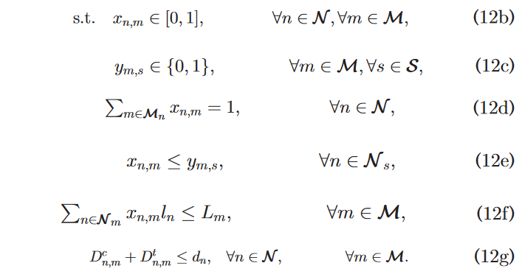
Problem
This is the Problem Formulation which X is user-allocation decision and Y is service-placing decision.

Slide 20
3

Slide 21
Solution
The paper introduce a local-search-based algorithm, LOCUS, which iteratively refines service placement and user allocation decisions to minimize total cost while satisfying user-perceived delay constraints.
The algorithm can be divided into two parts, a Mixed Integer Linear Programming (MILP) problem and a local sreach problem.

Slide 22
Solution
The paper introduce a local-search-based algorithm, LOCUS, which iteratively refines service placement and user allocation decisions to minimize total cost while satisfying user-perceived delay constraints.
The algorithm can be divided into two parts, a Mixed Integer Linear Programming (MILP) problem and a local sreach problem.

Slide 23
Solution
This MILP problem is NP-hard. So they need to reduce it to p-time.

Slide 24
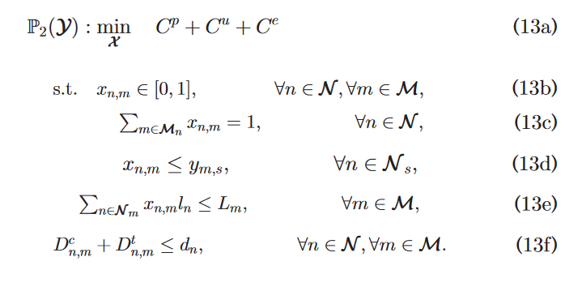
Solution
This MILP problem is NP-hard. So they need to reduce it to p-time.

Slide 25
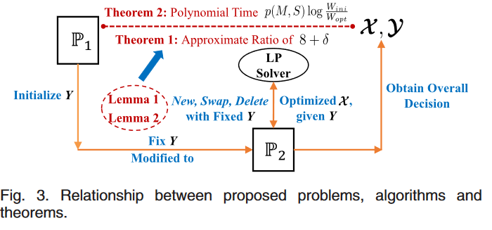
Solution
The authors reduce the MILP by fixing the service placement. And then they use a local search method to obtain the best the service placement decision Y. First, they initialize the service placement decision by adding all the needed service in the range of base station.

Slide 26
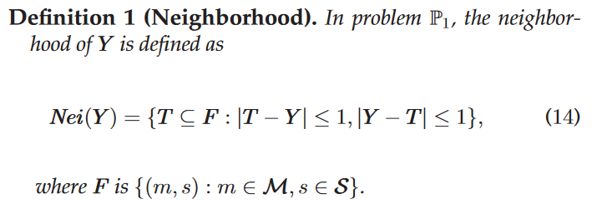
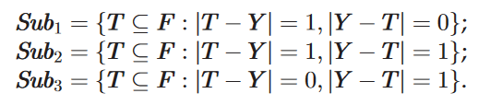
Solution
The authors reduce the MILP by fixing the service placement. And then they use a local search method to obtain the best the service placement decision Y.
New
Swap
Delete

Slide 27
Solution
The authors reduce the MILP by fixing the service placement. And then they use a local search method to obtain the best the service placement decision Y.
New
Swap
Delete

Slide 28
Solution
The authors reduce the MILP by fixing the service placement. And then they use a local search method to obtain the best the service placement decision Y.
We assume there are 3 tasks. The user’s task as following:
Task\User | 1 | 2 | 3 | 4 | 5 | 6 | 7 | 8
A | 1 | 0 | 0 | 1 | 0 | 0 | 1 | 0
B | 0 | 1 | 0 | 0 | 1 | 0 | 0 | 1
C | 0 | 0 | 1 | 0 | 0 | 1 | 0 | 0

Slide 29

Task\User | 1 | 2 | 3 | 4 | 5 | 6 | 7 | 8
A | 1 | 0 | 0 | 1 | 0 | 0 | 1 | 0
B | 0 | 1 | 0 | 0 | 1 | 0 | 0 | 1
C | 0 | 0 | 1 | 0 | 0 | 1 | 0 | 0
Solution
The authors reduce the MILP by fixing the service placement. And then they use a local search method to obtain the best the service placement decision Y.
\Server Task | 1 | 2 | 3
A | 1 | 1 | 1
B | 1 | 1 | 1
C | 0 | 1 | 1
$$Y$$
After we initialize the service placement decision $Y$.

Slide 30
Task\User | 1 | 2 | 3 | 4 | 5 | 6 | 7 | 8
A | 1 | 0 | 0 | 1 | 0 | 0 | 1 | 0
B | 0 | 1 | 0 | 0 | 1 | 0 | 0 | 1
C | 0 | 0 | 1 | 0 | 0 | 1 | 0 | 0
Solution
The authors reduce the MILP by fixing the service placement. And then they use a local search method to obtain the best the service placement decision Y.
\Server Task | 1 | 2 | 3
A | 1 | 1 | 1
B | 1 | 1 | 1
C | 0 | 1 | 1
$$Y$$
New
Swap
Delete
\Server Task | 1 | 2 | 3
A | 1 | 1 | 1
B | 1 | 1 | 1
C | 1 | 1 | 1
\Server Task | 1 | 2 | 3
A | 1 | 0 | 1
B | 1 | 1 | 1
C | 1 | 1 | 1
\Server Task | 1 | 2 | 3
A | 1 | 0 | 1
B | 1 | 1 | 1
C | 0 | 1 | 1
After we initialize the service placement decision $Y$.
New
Swap
Delete

Slide 31
Solution
Combined LP and Local Search Optimization. Algorithm can obtain the sub-optimal solution.

Slide 32
4

Slide 33
My Work
The paper formulized a offline model. In my previous work, a online SFC placement method is built.
If we consider SFC placement in this situation, we must notice that the data volume will change between VNF packages.
If we need to figure out an online method, we need to consider the mobilty and the randomness of task generation.

Slide 34
THANKS

